Slide 1
Computer Vision
Exercise Session 11 – Condensation Tracker

Slide 2
Assignment Tasks
Condensation tracker with color histogram observations
Experiment with the condensation tracker

Slide 3
General Tracking Framework
Prediction, based on system model f = system transition function
Update, based on measurement model h = measurement function is the history of observations

Slide 4
Condensation Tracker
The probability distribution is represented by a sample set S
- weights giving the sampling probability

Slide 5
Condensation Tracker
Prediction Start with , the sample set of the previous step, and apply the system model to each sample, yielding predicted samples
Update Sample from the predicted set, where samples are drawn with replacement with probability (using measurement model)

Slide 6
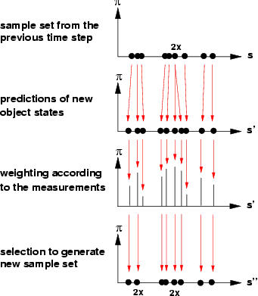
Condensation Tracker
Samples may be drawn multiple times, but noise will yield different predictions

Slide 7

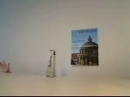
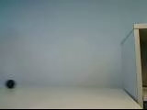
Task 2: Experiment with the Condensation Tracker
Moving hand
Uniform background
Moving hand
Clutter
Occlusions
Ball bouncing
Motion model

Slide 8
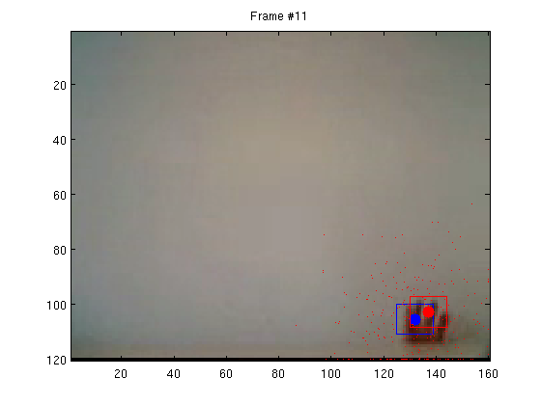
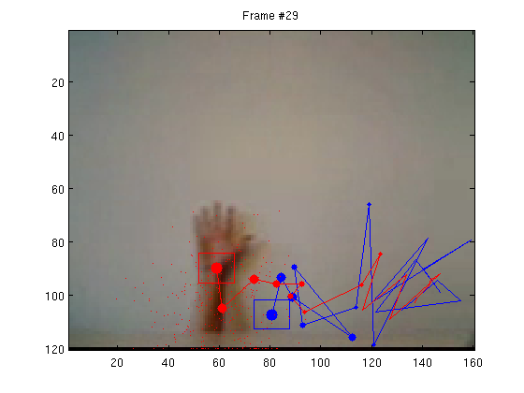
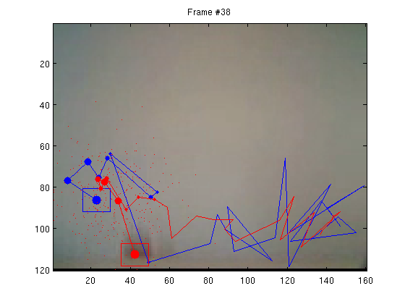
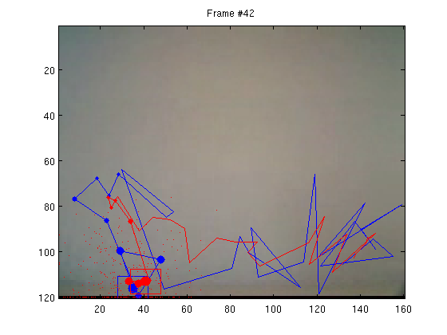
Video 1: Hand, uniform background
a priori mean state
a posteriori mean state

Slide 9
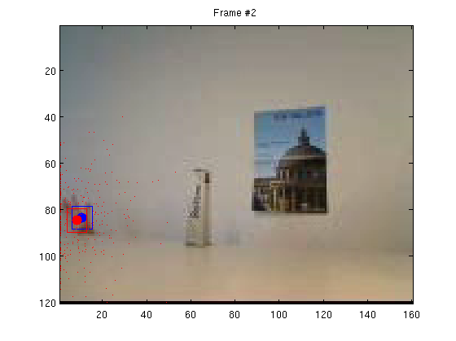
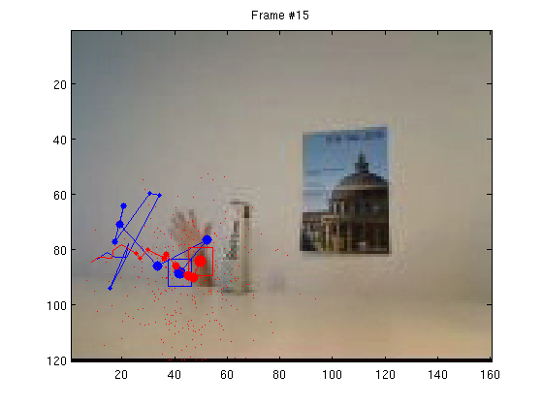
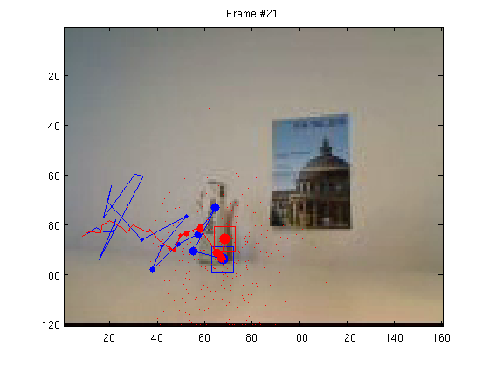
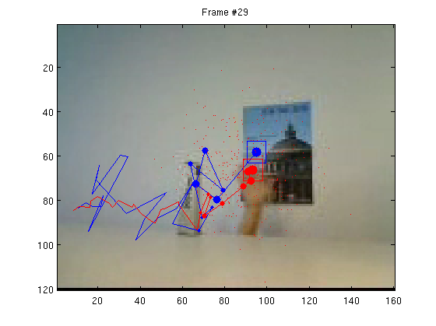
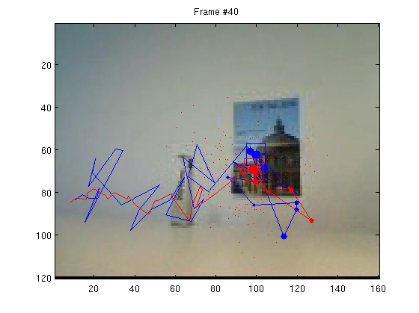
Video 2: Hand, clutter, occlusions
a priori mean state
a posteriori mean state

Slide 10
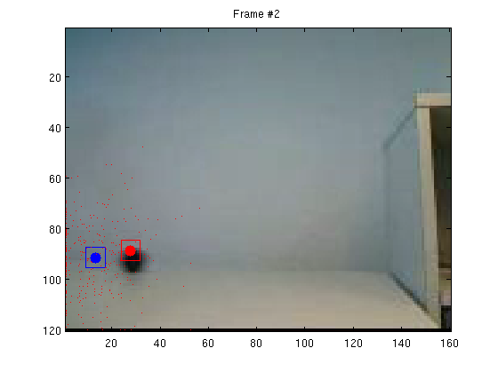
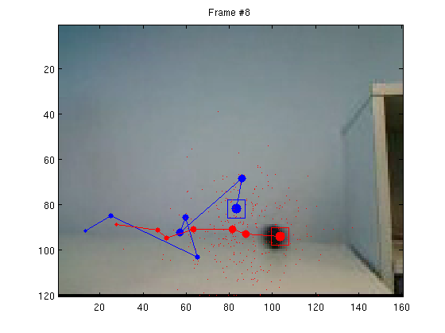
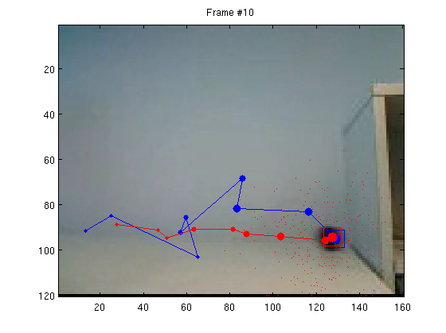
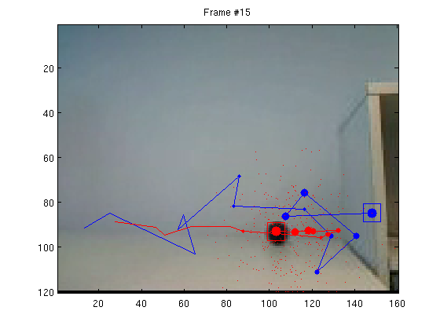
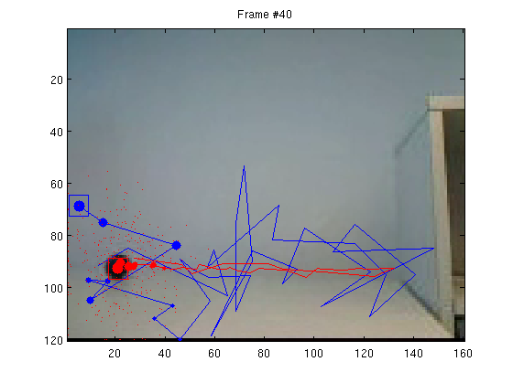
Video 3: Ball bouncing
a priori mean state
a posteriori mean state

Slide 11
Report
MATLAB code
We provide the overall structure
Write the code to perform each step of the CONDENSATION tracker
Plot the trajectories of the mean state
Experiment different settings
number of particles
number of bins for quantization
updating appearance model
motion model
Try your own video (bonus)

Slide 12
Hand-in
Hand in by 23:30 on 28th December 2018
to Moodle

